Slide 1


MySQL
Presented by Awais Manzoor, Data Analyst
Click here

Slide 2

https://www.linkedin.com/in/awaismanzoor11227/
SELECT Statement
The SELECT statement is used to retrieve data from a database.
Syntax
SELECT column1, column2, ... FROM table_name;
Example
SELECT * FROM students;
Notes:
The SELECT statement is the most commonly used SQL statement for retrieving data from a database. It allows you to specify the columns you want to retrieve from a table. The syntax is straightforward - you list the column names after the SELECT keyword, and then specify the table name after the FROM keyword. The example shows how you can use the * wildcard to select all columns from the students table. This is a simple but powerful way to retrieve data, and forms the foundation for many more complex SQL queries.

Slide 3

WHERE Clause
The WHERE clause is used to filter records by specifying conditions that the data must meet.
Syntax
SELECT column1, column2, ... FROM table_name WHERE condition;
Example
SELECT * FROM students WHERE gender = 'male';

Slide 4


Operators
Operator
Description
=
Checks if the values are equal
>
Checks if the left value is greater than the right value
<
Checks if the left value is less than the right value
>=
Checks if the left value is greater than or equal to the right value
<=
Checks if the left value is less than or equal to the right value
<>
Checks if the values are not equal. Note: In some SQL versions, this operator can be written as !=
BETWEEN
Selects values within a specified range, inclusive
LIKE
Searches for a specified pattern in a column
IN
Specifies multiple possible values for a column to match

Slide 5

LIKE - Searches for a Pattern
Example Query:
SELECT * FROM EMP WHERE ENAME LIKE '%T';
This query retrieves all employee names that end with the letter 'T'. The percent sign (%) is a wildcard character representing any sequence of characters.
https://www.linkedin.com/in/awaismanzoor11227/

Slide 6

LIKE Operator
SELECT *
FROM EMP
WHERE ENAME LIKE 'T%';
This query retrieves all employee names that begin with the letter 'T'. The percent sign (%) is a wildcard that represents any sequence of characters.

Slide 7

"IN" Operator
Syntax
The IN operator allows you to specify multiple possible values for a column in the WHERE clause.
SELECT column_name(s)
FROM table_name
WHERE column_name IN (value1, value2, ...);
Example
SELECT *
FROM EMP
WHERE JOB IN ('SALESMAN', 'CLERK');
This query retrieves all rows from the EMP table where the JOB column matches either 'SALESMAN' or 'CLERK'.

Slide 8

BETWEEN Operator
Syntax
SELECT column_name(s) FROM table_name WHERE column_name BETWEEN value1 AND value2;
Example
SELECT * FROM emp WHERE SAL BETWEEN 500 AND 2000;

Slide 9

COUNT Function
Syntax
SELECT COUNT(column_name) FROM table_name WHERE condition;
Example:
SELECT COUNT(ENAME) AS Total_Employees FROM emp;
The AS keyword assigns an alias to the result of the COUNT function, making it easier to reference the output in the query results.
This function returns the total number of non-null values in the specified column.

Slide 10



SUM
https://www.linkedin.com/in/awaismanzoor11227/
Syntax
SELECT SUM(column_name)FROM table_name
Example
SELECT SUM(SAL) AS Total_SalaryFROM emp;

Slide 11

The SQL MIN() and MAX() Functions
MIN()
MAX()
The MIN() function returns the smallest value of the selected column.
The MAX() function returns the largest value of the selected column.
SELECT MIN(column_name)FROM table_nameWHERE condition;

Slide 12

AVG() Function
The AVG() function calculates the average value of a numeric column.
SELECT * FROM Products WHERE price > (SELECT AVG(price) FROM Products);

Slide 13

SQL JOIN
Definition
1
A JOIN clause is used to combine rows from two or more tables based on a related column between them.
2
Example
Consider the following example selection from the Orders table:
SELECT Orders.OrderID, Customers.CustomerName, Orders.OrderDate
FROM Orders
INNER JOIN Customers ON Orders.CustomerID = Customers.CustomerID;

Slide 14
CustomerID
CustomerName
ContactName
Address
City
PostalCode
Country
1
Alfreds Futterkiste
Maria Anders
Obere Str. 57
Berlin
12209
Germany
2
Ana Trujillo Emparedados y helados
Ana Trujillo
Avda. de la Constitución 2222
México D.F.
05021
Mexico
3
Antonio Moreno Taquería
Antonio Moreno
Mataderos 2312
México D.F.
05023
Mexico

Slide 15
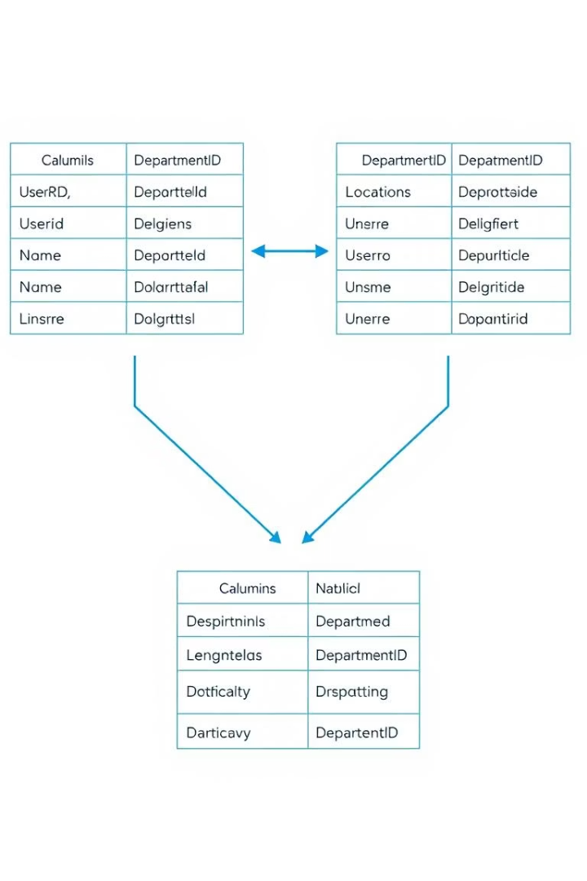
Understanding INNER JOIN
Core Function
Matching Requirement
The INNER JOIN keyword retrieves rows from both tables where there is a match in the specified columns.
It only includes records if there is a matching entry in both the "Orders" and "Customers" tables.
Exclusion Rule
Orders without a matching customer in the "Customers" table are not shown.
SELECT Orders.OrderID, Customers.CustomerNameFROM OrdersINNER JOIN Customers ON Orders.CustomerID = Customers.CustomerID;

Slide 16

Order Details
OrderID
CustomerName
OrderDate
10308
Ana Trujillo Emparedados y helados
9/18/1996
10365
Antonio Moreno Taquería
11/27/1996
10383
Around the Horn
12/16/1996
10355
Around the Horn
11/15/1996
10278
Berglunds snabbköp
8/12/1996

Slide 17
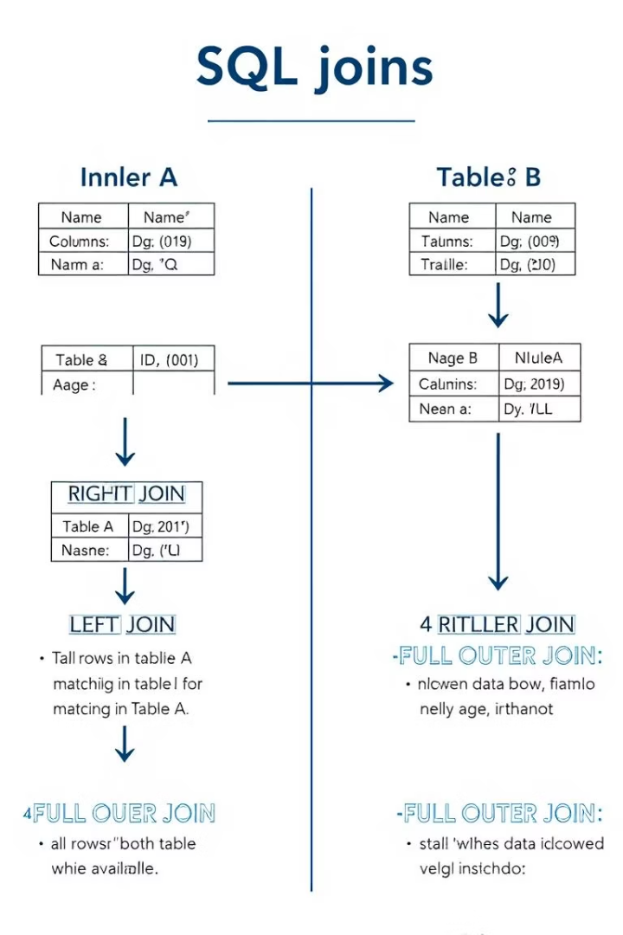




SQL Join Types
LEFT (OUTER) JOIN
(INNER) JOIN
Returns records that have matching values in both tables
Returns all records from the left table, and the matched records from the right table
1
2
4
RIGHT (OUTER) JOIN
FULL (OUTER) JOIN
3
Returns all records from the right table, and the matched records from the left table
Returns all records when there is a match in either left or right table

Slide 18

LEFT JOIN
What it does
Syntax
The LEFT JOIN keyword returns all records from the left table (table1), and the matching records from the right table (table2).
SELECT column_name(s)
FROM table1
LEFT JOIN table2
ON table1.column_name = table2.column_name;
The result is 0 records from the right side, if there is no match.

Slide 19




The SQL AND, OR and NOT Operators
AND
OR
NOT
Displays records if ALL conditions are TRUE.
Displays records if ANY condition is TRUE.
Displays records if the condition is NOT TRUE
.

Slide 20



The SQL INSERT INTO Statement
The INSERT INTO statement is used to insert new records in a table.
INSERT INTO Syntax
It is possible to write the INSERT INTO statement in two ways:
1. Specify both the column names and the values to be inserted:

Slide 21

INSERT INTO
Syntax
INSERT INTO table_name (column1, column2, column3, ...)VALUES (value1, value2, value3, ...);

Slide 22

'ORDER BY' Keyword
1
The ORDER BY keyword is used to sort the result-set in ascending or descending order.
2
SYNTAX
SELECT column1, column2, ...
FROM table_name
ORDER BY column1, column2, ... ASC|DESC;
The ORDER BY keyword sorts the records in ascending order by default. To sort the records in descending order, use the DESC keyword.
3
SELECT * FROM CustomersORDER BY Country DESC;

Slide 23



GROUP BY
Purpose
The GROUP BY statement groups rows that have the same values into summary rows, like "find the number of customers in each country".
Usage
The GROUP BY statement is often used with aggregate functions (COUNT(), MAX(), MIN(), SUM(), AVG()) to group the result-set by one or more columns

Slide 24



ORDER BY
The Purpose
The ORDER BY keyword is used to sort the result-set in ascending or descending order.
Default Behavior
The ORDER BY keyword sorts the records in ascending order by default. To sort the records in descending order, use the DESC keyword.
Example
SELECT * FROM Customers
ORDER BY Country DESC;

Slide 25

Thank You!
Click here

